Slide 1
Mojaloop infrastructure Update
July 2022
Tom Daly (Crosslake Technolgies) , David Fry (ModusBox)
1

Slide 2
Agenda
workstream overview (wip)
mini-loop update
IaC update
2

Slide 3
Workstream
3

Slide 4
Status
Workstream to assist users to “onboard” Mojaloop
Initiated April 2022 conference (Arusha)
Initial proposal slide deck created
Initial discussions undertaken
Next meetings (focus group) scheduled
Deployment infrastructure exists today
mini-loop v4.0 (demo)
IaC (production)
https://docs.google.com/presentation/d/1EJme7Db6d2VWb8yigH-56WirFjfzNqoi5Oc_g-Q2b-w/edit?usp=sharing
4

Slide 5
Overview / top-level summary
Mini-loop (DEMO)
Level 1
ML Sandbox (medium)
(non-POC) Level 2
ML Sandbox (medium)
(POC) Level 3
ML Production (large)
Level 4
Main purpose(s):
to get switch up and running in the least time , requiring least resources and expertise from the user. To enable cheap automated testing in pipelines
Audience :
Students
first-time Mojaloop users
code and chart developers
Functional and performance testers
Architecture
Shell scripts
Non-strict security
Mostly single k8s node
Little-no redundancy
Main purpose(s):
allow fake money on fake rails , support fintechs but NOT account holding institutions
Audience :
Students
Fintechs
Business folks
?
Architecture
Terraform install ?
Security – medium
Single and multi-node
Little redundancy
No lifecycle support
Main purpose(s):
allow fake money on fake rails AND support POCs
Audience :
Account Holding Institutions
Fintech's
Governments
Architecture
Terraform install ?
Security – medium
Single and multi-node
Little redundancy
lifecycle support
Main purpose(s):
Level 1 project goals
Audience :
Governments
Level 1 project targets
Architecture
Terraform – IaC
Robust security
Robust lifecycle support
Scale-out
etc
DRAFT

Slide 6
mini-loop update
6

Slide 7
Kubernetes Releases
Kubernetes releases every 3 months (see https://kubernetes.io/releases/)
Kubernetes maintains 3 most recent releases: (July 2022) 1.24, 1.23 and 1.22
Kubernetes 1.21 EOL-d in June 2022
Current releases can expect 12 months of (patch) support from kubernetes.io
Kubernetes vendors support windows vary in-line with kubernetes.io
Canonical (Microk8s), Rancher (k3s) , Kubernetes.io (kubespray) etc
Cloud Vendors : Azure (AKS), AWS (AKE) , Google (GKE), Oracle (OKE) etc
API versions roll into and out of the kubernetes release window(s). e.g.
networking.k8s.io/v1beta1 is no longer served/available from v1.22 (use networking.k8s.io/v1) Note though this was deprecated in v1.19 in or around August 2020
Docker is deprecated in current releases and will soon be removed
The policy/v1beta1 API version of PodDisruptionBudget will no longer be served in v1.25.

Slide 8
Mojaloop falling behind Kubernetes release schedules * Implications *
We are making it much harder for people to interact with Mojaloop !
We are allowing impediments to people adopting Mojaloop
We are allowing obstacles to our goal of “growing the Mojaloop community”
We are providing repetitive, expensive support on mojaloop-help

Slide 9
Mojaloop Issues w.r.t Kubernetes Releases
Issue #1
Current helm charts use EOLd API networking.k8s.io/v1beta1
Also related to this is https://github.com/mojaloop/project/issues/2448
Issue #2
Current helm charts rely on a deprecated helm chart for percona database and it is broken for use with containerd. (https://github.com/mojaloop/project/issues/2447)
Issue #3
Current helm charts use EOLd API policy/v1beta1 API (no longer served in k8s v 1.25)

Slide 10
mini-loop solution today
mini-loop branch (k8sv1.24) will be mini-loop v4.0 by Aug 2022
Mini-loop automation : 3 steps to running Mojaloop
Takes care of OS and k8s pre-requisites
Installs microk8s or k3s (user selected version)
Installs correct helm
Installs correct ingress
Configures user env for k8s and Mojaloop
1
2
Run k8s-install-current.sh
Git clone mini-loop repo
clones the latest ML charts
Modify charts in local repo to run with 1 db and latest k8s APIs
generates and uses a non-default database pw (see #2720 )
deploys a db with this pw
deploys mojaloop
performs end-point health checks and reports any issues
3
Run miniloop-local-install.sh

Slide 11
mini-loop facilitates testing
Across OS, across kubernetes release and kubernetes distribution
Mini-loop automation : 3 steps to running Mojaloop
Installs microk8s or k3s (user selected version)
Takes care of OS and k8s pre-requisites
Installs correct ingress
Installs correct helm
Configures user env for k8s and Mojaloop
1
2
Git clone mini-loop repo
Run k8s-current-install.sh
clones the latest ML charts
Modify charts in local helm repo to run with 1 db and latest k8s APIs
generates and uses a non-default database pw (see #2720 )
deploys a db with this pw
deploys mojaloop
performs end-point health checks and reports any issues
3
Run miniloop-local-install.sh

Slide 12
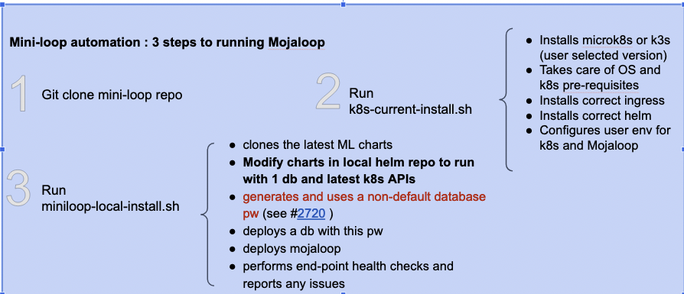
mini-loop facilitates testing
miniloop-test.sh - test harness for mojaloop deployment
USAGE: ./miniloop-test.sh -m <mode> -u <user> -k <k8s distro(s)> [-t]
Example 1 : ./miniloop-test.sh -m test_ml -u mluser # test both microk8s and k3s using user mluser
Example 3 : ./miniloop-test.sh -m test_ml -k -u user k3s
Options:
-m mode .................... test_ml
-k kubernetes distro... microk8s|k3s|both (scope of tests)
-u user ....................... non root user to run helm and k8s commands and
to own mojaloop deployment
-t ................................. run helm tests
-h|H ............................. display this message

Slide 13
Mojaloop deployment testing results June 2022 w/o mini-loop 4.0 mods
Operating System | Hardware/ VM (if known) | Kubernetes Distro | Kubernetes version | Docker Y/N | Deploys & Runs | Observations / Results
Ubuntu (16,18,20) | AWS VM + other intel server | Microk8s | 1.20 1.21 1.22+ | N N N | Y N N | ML deploys and runs ML deploys but does not run due to https://github.com/mojaloop/project/issues/2447 ML does not deploy as ML charts use api deprecated in kubernetes v1.19 and removed in v1.22
Ubuntu (16,18,20) | AWS VM | K3s | 1.20 1.21 | Y Y | N Y | ?? (not sure of precise issues here but k3s did not deploy) ML Deploys and runs
Fedora 36 | AWS VM Intel Laptop | Microk8s Microk8s | 1.20 1.21 | N N | N N | Could not reliably deploy Microk8s on Fedora 36 ( snapd seems buggy on platforms other than ubuntu ) Could not reliably deploy Microk8s on Fedora 36 ( snapd seems buggy on platforms other than ubuntu )
Fedora 36 | AWS VM + Intel Laptop | K3s K3s | 1.21 1.21 | Y N | N N | ML deploys but does not run the databases have an error related to docker volumes not being empty ML deploys but does not run due to https://github.com/mojaloop/project/issues/2447
Redhat 8 | AWS VM AWS | Microk8s K3S | 1.20 1.21 | N N | N N | Could not reliably deploy Microk8s on Redhat 8 (snapd seems buggy on platforms other than ubuntu)
Oracle Linux 8 | X86 VM on OCI | Microk8s | 1.20 | N | N | Could not reliably deploy Microk8s on Oracle Linux (snapd seems buggy on platforms other than ubuntu)
* Note only testing x86_64 architecture so far
* AWS VM = VMs generally t2.xlarge shape with 8-16GB ram and 64 GB disk (SSD)
* I am continuing testing across other infrastructure too e.g. OCI VMs and GCP hopefully the near term
* regarding the TTK Golden path tests , these have been passing and failing recently in the normal testing pipeline so further investigation is needed. (Note: We would also benefit from making the test report much easier to save and share as today it relies on AWS storage. ) Its on me to file an issue for this per advice/conversations with Miguel.

Slide 14
Mojaloop deployment testing results July 2022 with mini-loop mods
Operating System | Hardware/ VM (if known) | Kubernetes Distro | Kubernetes version | Deploys & Runs | Observations / Results
Ubuntu (16,18,20) | AWS VM + other intel server | Microk8s | 1.22-1.24 | Y | deploys and runs passes GP
Ubuntu (16,18,20) | AWS VM | K3s | 1.22-1.24 | Y | deploys and runs passes GP
Fedora 36 | AWS VM + Intel Laptop | K3s K3s | 1.22-1.24 | N | too many open files error
Redhat 8 | AWS VM AWS | K3s | 1.22-1.24 | Y | deploys and runs passes GP

Slide 15
IaC update
15

Slide 16
Infrastructure Purposes - Refresher from last PI
Infrastructure for Mojaloop has different use cases
Dev who wants to quickly kick the tires
TTK mocking the switch and other participants - can run standalone on docker
Potential switch operator whose development team needs to experiment with a full dev env
miniloop version
Sandbox for hackathon/etc
IaC from mojaloop
Vendor specific quick start
PoC for country wide switch
IaC from mojaloop
Vendor specific quick start
Production Grade switch
Consult vendors to provide production capabilities for fault-tolerance, security and throughput.
Notes:
⚙

Slide 17
IaC History - Refresher from last PI
Sandbox Infrastructure for Mojaloop has evolved over the years
Initial Mojaloop Infrastructure efforts started on AWS
We leveraged this as starting point so base IaC has been implemented on AWS.
We have also made use of early adopters' choice of components but we have gradually been replacing these with best of breed open source components.
Notes:
⚙

Slide 18
IaC Principles - Refresher from last PI
Core principles guiding the development of the Sandbox IaC effort
Open Source and standards based components ✅
Cloud Provider Agnostic ✅ (still needs testing with different cloud provider)
Fit for purpose:
Sandbox ✅
Fake Money/Fake Rails ✅
Striving for pluggable architecture to achieve multi-cloud capability including bare-metal ✅
Support lower resource requirements
Elimination of all manual steps (scripts/etc) to provision switch, rely on idempotent operations to reach desired infrastructure state. (pretty close to 95%)
Provide upgrade path for most components
These principles provide the following benefits:
All capabilities can be tested without reliance on licensed components
Anyone can use as a starting point for their infrastructure without licensing issues.
Notes:
⚙

Slide 19
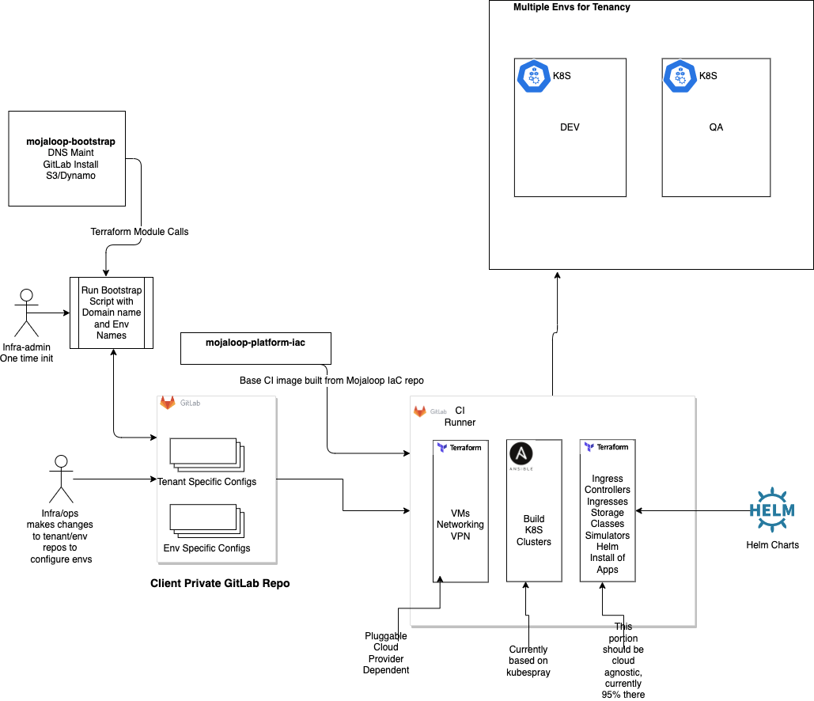
Supporting Multiple Cloud Providers
Notes:
⚙

Slide 20
IaC Current Components - Refresher from last PI
Bootstrap provides tenancy components for base networking (VPC, subnets, DNS, CI, configuration management and VPN). This is highly cloud provider specific.
Environment IaC is layered terraform modules that first builds VMs (cloud provider specific) after which the rest of the architecture is built in a mostly cloud agnostic fashion.
These cloud agnostic components include:
Hashicorp Vault
Certificate Manager
External DNS
WSO2 ISKM (moving to keycloak)
WSO2 API Manager (moving to ambassador/ORY)
Nginx Ingress Controller
HAProxy (for forward proxying requests to DFSP callbacks)
Connection Manager
Bizops Framework (leveraging ORY)
Notes:
⚙

Slide 21
IaC Cloud Agnostic Progress
After the last PI, work was done to modify the IaC terraform setup to more easily support pluggable cloud providers and/or managed kubernetes service providers.
This refactoring effort has been performed and tested using the cloud-agnostic branch in the IaC repo: https://github.com/mojaloop/iac-aws-platform/tree/cloud-agnostic
These changes include:
Structural changes to the terraform directories to make it easier to plug in different cloud specific modules.
Refactorings to completely remove all references to cloud provider in the application-specific modules. This should allow for replacement of cloud provider by rewriting only 2 modules.
Use of terragrunt to simplify the modularization and to reduce copy and paste coding for maintaining module versions and variables. This includes configuring inter module dependencies.
Consolidated state management for terraform (S3/Dynamo, looking to move to gitlab)
General refactoring of modules to address technical debt from earlier versions.
IaC updated to make use of terragrunt and refactored directory structure.
Notes:
⚙

Slide 22
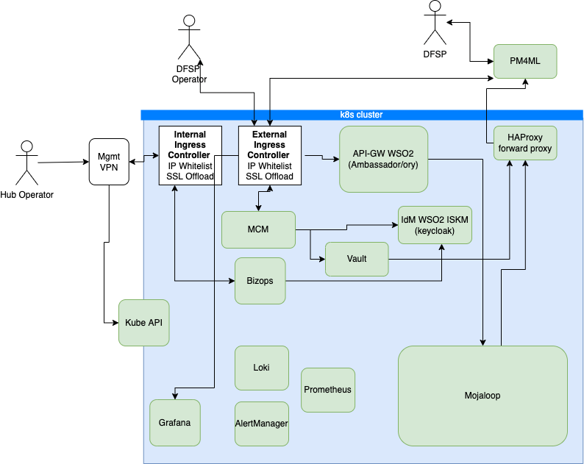
Mojaloop Operating Environment
Major Components
This is the Mojaloop Helm Release
Notes:
⚙

Slide 23
IaC Cloud Agnostic Progress
Terraform/Terragrunt Directory Structure
terraform
├── aws_provider.hcl
├── base-infra-aws
├── base-k8s-setup
├── common_vars.yaml
├── k8s-apps-setup
├── modules
└── remote_state.hcl
terraform/base-infra-aws
├── create-infrastructure.tf
├── k8s-clusters.tf
├── loadbalancers.tf
├── outputs.tf
├── ssh_key.tf
├── templates
├── terragrunt.hcl
└── variables.tf
terraform/base-k8s-setup
├── ext-dns-aws.tf
├── letsencrypt-issuer-aws.tf
├── main.tf
├── outputs.tf
├── storage.tf
├── templates
├── terragrunt.hcl
└── variables.tf
Cloud Vendor Specific
Notes:
⚙

Slide 24
IaC Cloud Agnostic Progress
Terraform/Terragrunt Directory Structure
terraform/k8s-apps-setup
├── apps
│ └── wso2
├── mojaloop-core
│ ├── alias-oracle.tf
│ ├── bizops.tf
│ ├── iskm-bizops.tf
│ ├── k8s-finance-portal.tf
│ ├── k8s-manifests
│ ├── k8s-mojaloop.tf
│ ├── local-provider.tf
│ ├── mfi-account-oracle.tf
│ ├── mfi-p2p-oracle.tf
│ ├── mojaloop-custom-reports
│ ├── mojaloop-roles
│ ├── outputs.tf
│ ├── publicapi.tf
│ ├── templates
│ ├── terragrunt.hcl
│ └── variables.tf
├── pm4mls
│ ├── local_data.tf
│ ├── onboard_external_pm4ml.tf
│ ├── onboard_pm4ml.tf
│ ├── terragrunt.hcl
│ └── variables.tf
├── post-config
│ ├── local_data.tf
│ ├── mcm_pm4ml_create.tf
│ ├── onboarding_setup.tf
│ ├── templates
│ ├── terragrunt.hcl
│ ├── user_creation.tf
│ ├── variables.tf
│ └── whitelist.tf
├── state-setup
│ ├── external-svcs.tf
│ ├── kafka-stateful-resources.tf
│ ├── mongo-stateful-resources.tf
│ ├── mysql-stateful-resources.tf
│ ├── templates
│ ├── terragrunt.hcl
│ └── variables.tf
└── support-svcs
…
Notes:
⚙

Slide 25
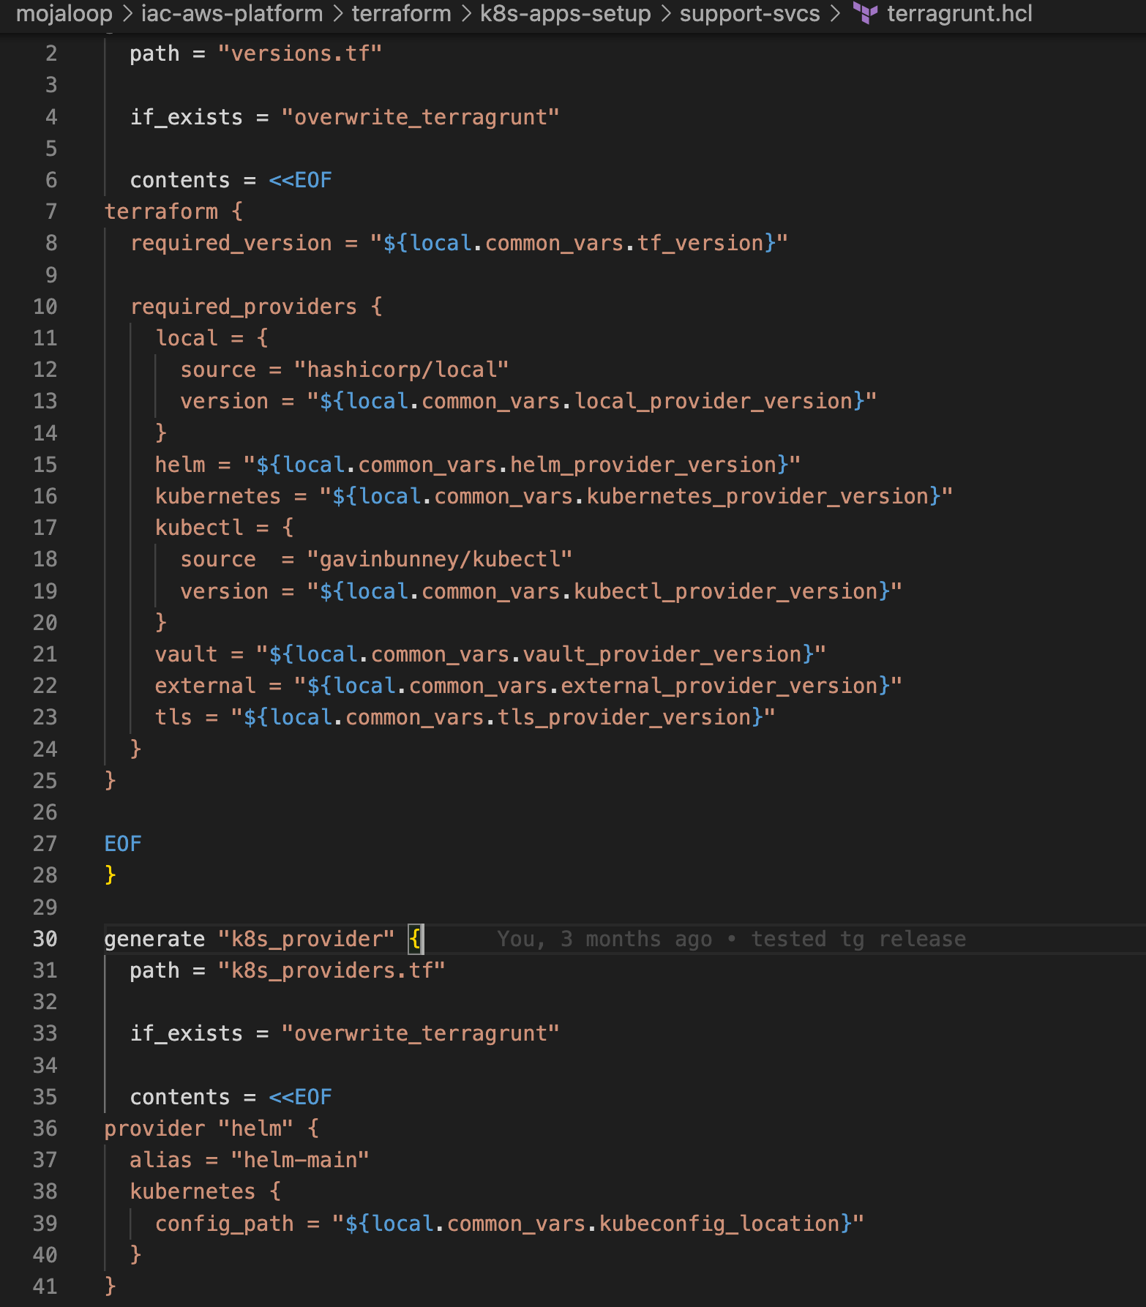
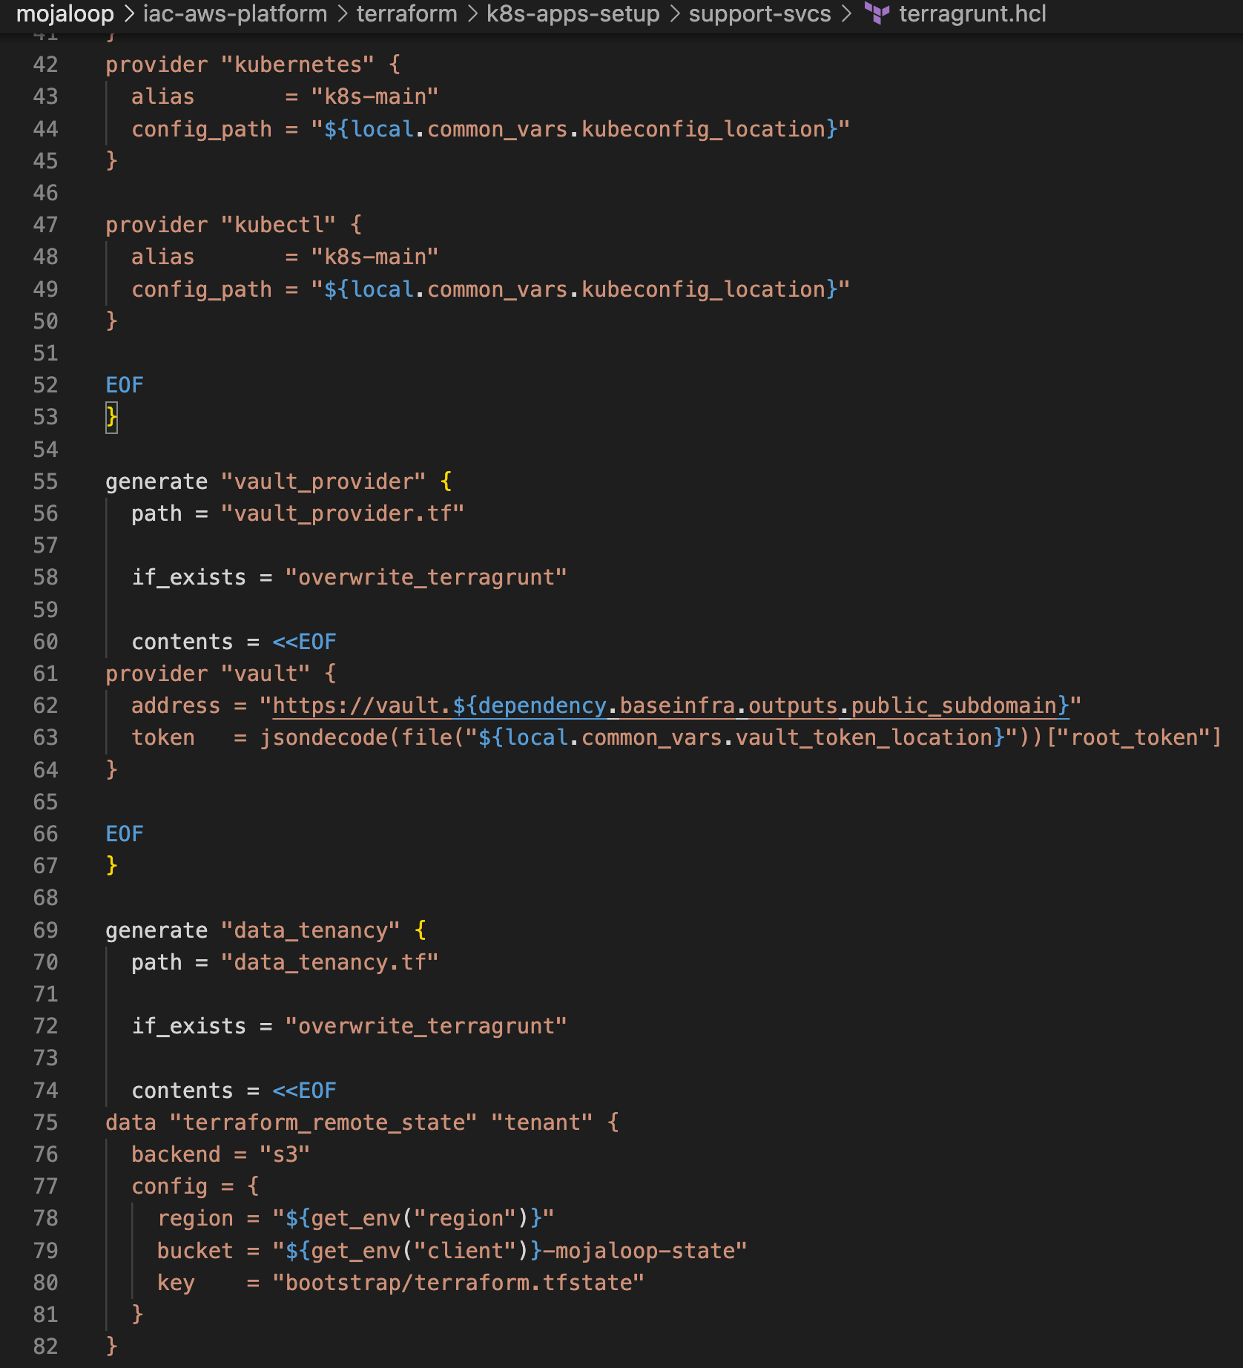
Terragrunt Code Examples
Notes:
⚙

Slide 26
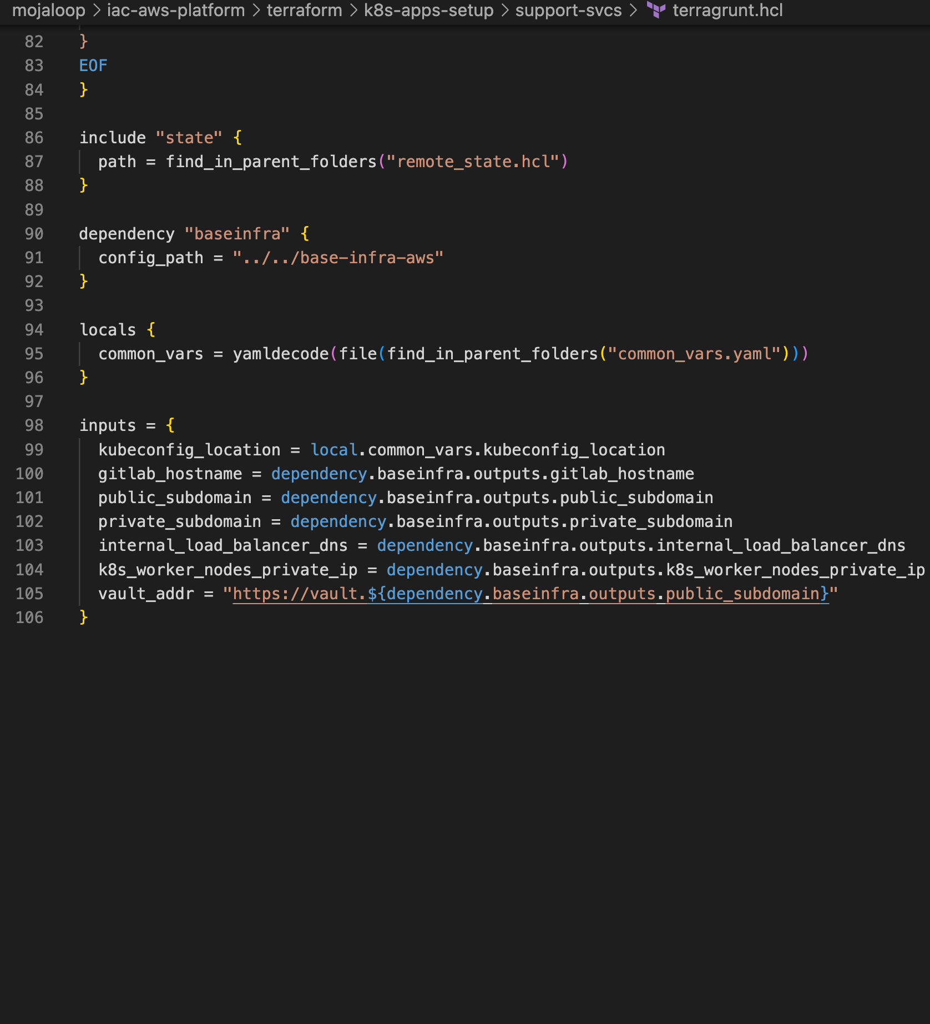
Terragrunt Code Examples
Notes:
⚙

Slide 27
IaC Cloud Agnostic Progress
Terraform/Terragrunt common_vars.yaml
tf_version: ">= 1.1"
local_provider_version: "~> 2.2"
aws_provider_version: "~> 3.74"
helm_provider_version: "~> 2.3"
vault_provider_version: "~> 3.0"
kubernetes_provider_version: "~> 2.6"
kubectl_provider_version: ">= 1.13"
external_provider_version: "~> 1.2.0"
tls_provider_version: "~> 2.0"
ansible_provider_version: "~> 1.0"
restapi_provider_version: "~> 1.16.2"
kubeconfig_location: "/iac-run-dir/envs3/k8s/admin.conf"
shared_state_location: "/iac-run-dir/envs3"
vault_token_location: "/iac-run-dir/envs3/vault/vault_seal_key"
static_files_path_location: "/iac-run-dir/static_files"
bof_custom_resources_dir: "/iac-run-dir/bof-custom-resources"
Notes:
⚙

Slide 28
IaC PI-18 status summary
Finalized release of
Creation of Stateful Resources separate from the helm releases that make use of them in preparation for release v14.
Kafka
MySQL
MongoDB
Full removal of manual certificate and DNS provisioning, completed move to
External DNS
Cert Manager (using LetsEncrypt and Vault issuers)
Moved off of EFK to use Loki along with Grafana stack
First cloud-agnostic code base implemented on AWS
Next Steps
Test cloud-agnostic version with either kubespray on different cloud provider or with managed K8S.
Move from WSO2 ISKM to Keycloak
Move from WSO2 APIM to Ambassador
Convert ESP to make use of grafana stack
Move away from s3/dynamo for terraform and ci state to gitlab/minio
Notes:
⚙

